Slide 2
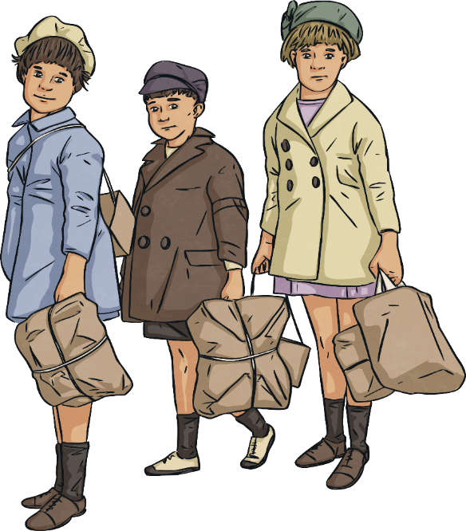
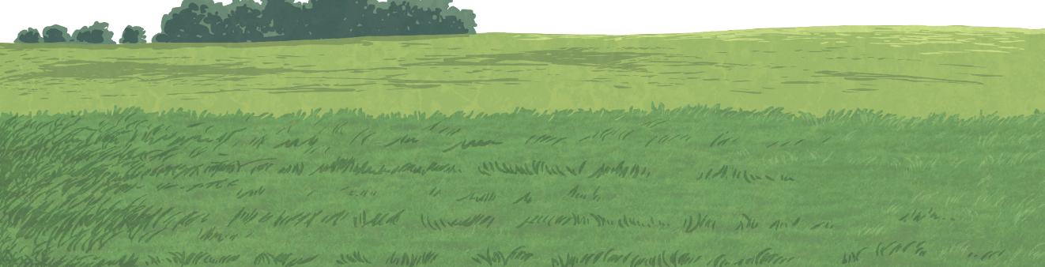

Music of the 1940s
Since the start of the 20th century, certain genres of music have been popular in different decades.
Today, we are going to learn about music from the 1940s.
Which major historical event
took place during this decade?
genre: A style of art, music or literature.

Slide 3



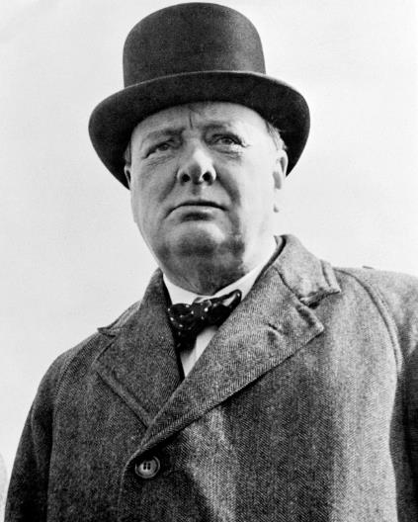
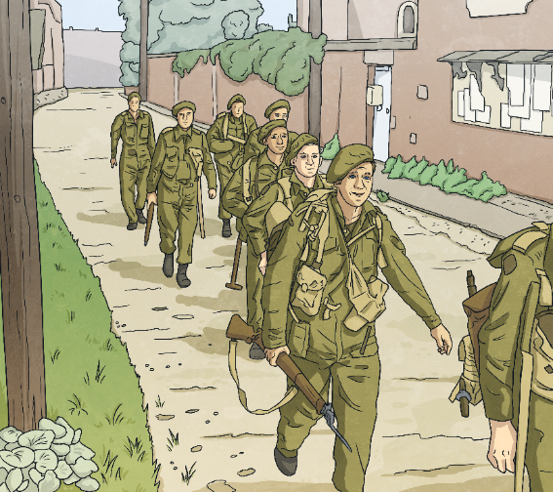
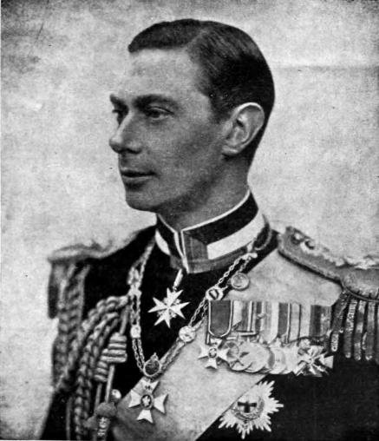
The 1940s
The 1940s were dominated by The Second World War. The war began in 1939 and ended in 1945.
Rationing was introduced and millions of men went to fight in the war against Germany and its leader, Adolf Hitler. Children were evacuated, away from threatened cities, to live in safer places.
Winston Churchill became the UK Prime Minister in 1940.
Queen Elizabeth II’s father, King George VI, was on the throne during this decade.
rationing: There was a national shortage of food so it had to be limited. Rationing was a way of making sure that everyone got a fair share of food.

Slide 4
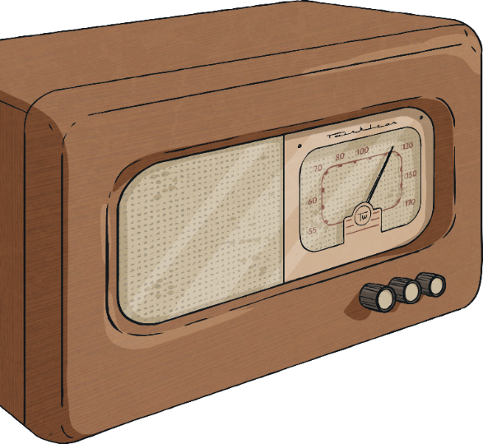
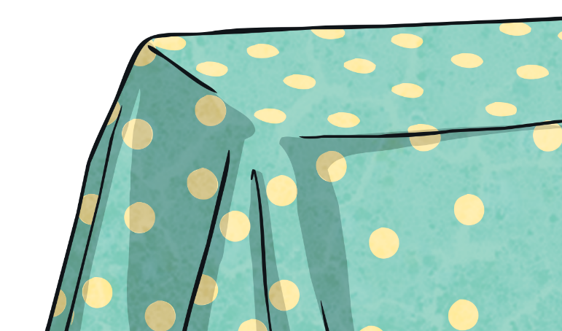
Radio
During wartime, entertainment was important for maintaining morale. Many people listened to music on the radio.
The BBC began broadcasting ‘Music While You Work’. The idea was to play non-stop music to help workers become more productive and keep spirits high.
Did You Know…?
At this time, a radio was called a wireless.
morale: The confidence and enthusiasm of a person or group at a particular time.

Slide 5
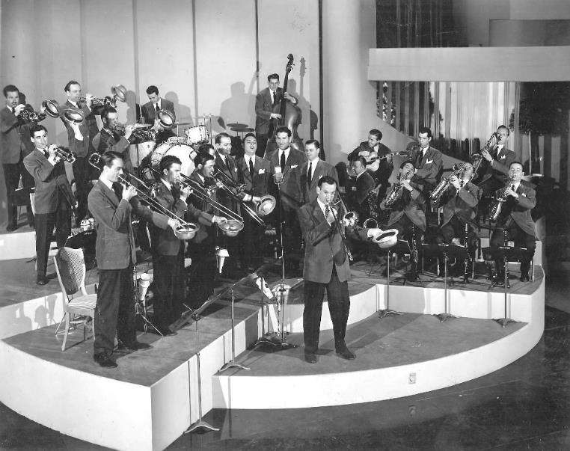
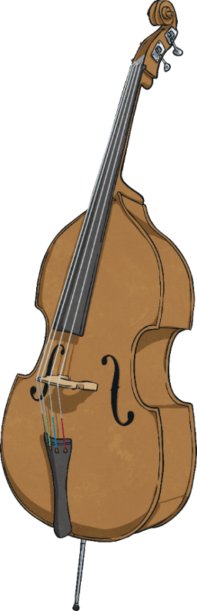
Big Band Music
Big band music became popular in the 1940s. It was music that you could easily dance to and involved a big band and a bandleader.
Bandleaders led
musical ensembles
with at least ten members. There were saxophones, trumpets, trombones and other instruments, such as
the piano, double bass, drums and guitar.
musical ensemble: A group of musicians who perform instrumental or vocal music.

Slide 6
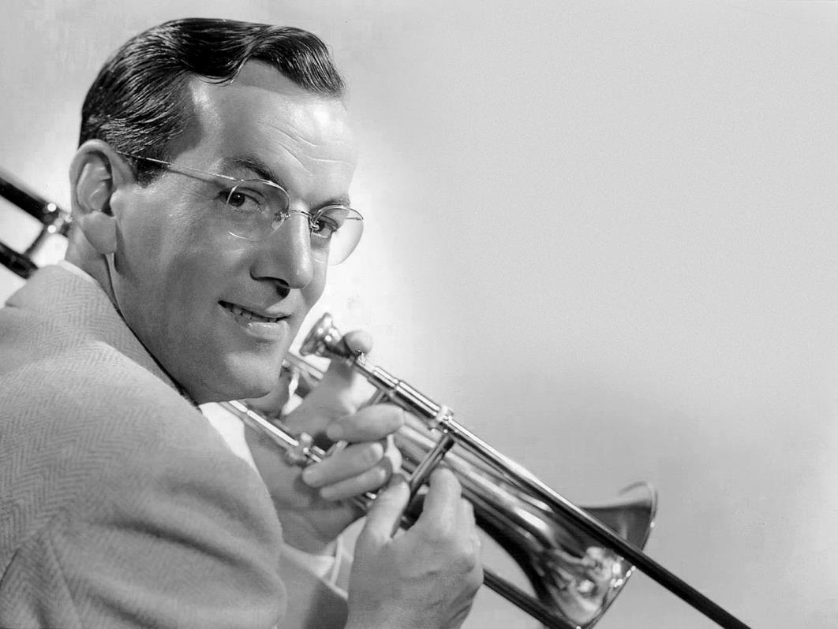
Big Band Music
Famous bandleader and musician, Glenn Miller, was one of the most popular bandleaders of the time. He also played the trombone and wrote music.
Some of The Glenn Miller Orchestra hits from the 1940s included ‘Pennsylvania 6-5000’, ‘Moonlight Serenade’ and ‘Chattanooga Choo Choo’.
In 1942, Glenn signed up to join the U.S Army Air Force to help in the war effort.
He died in 1944 when his military flight from England To France disappeared in bad weather.
Think About It!
Why do you think many musicians of this era tried to create upbeat and positive music?

Slide 7
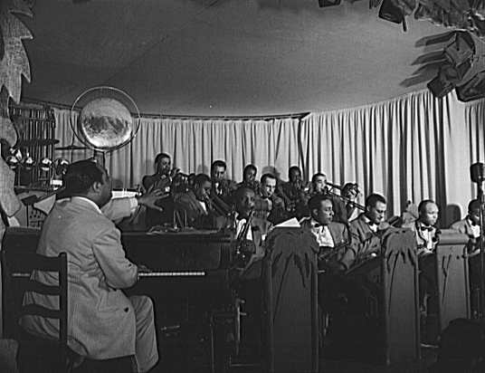
Bandleaders
Bandleaders worked on different arrangements of the same song. It was quite common to see the same song appear in the music charts at the same time but by a different artist.
Big bands, such as Duke Ellington and his orchestra, would play night after night at clubs while touring.

Slide 8

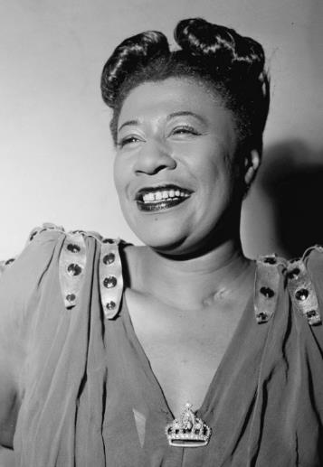
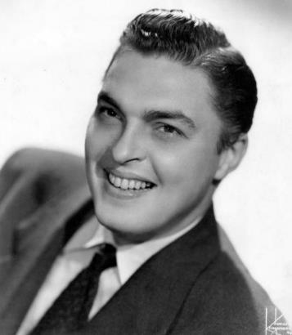
Big Band Singers
Big bands could have male or female singers. Many of the famous artists of the day performed with these bands, such as Bob Eberly and Ella Fitzgerald.
Unfortunately, during The Second World War, many clubs decided to hire smaller bands because they were cheaper which led to many big bands finishing during the 1940s.
Ella Fitzgerald
Bob Eberly

Slide 9

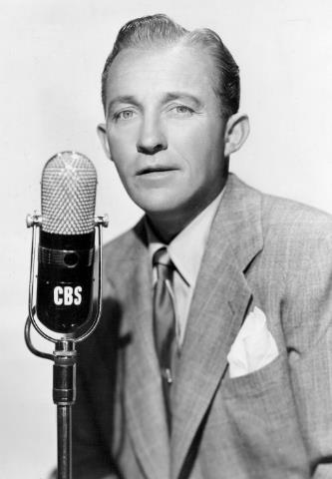
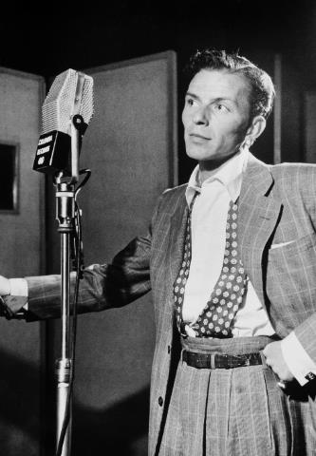
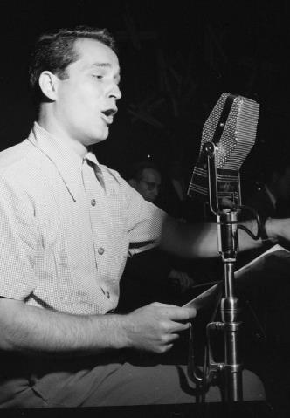
Crooners
Ella Fitzgerald
Bing Crosby
Frank Sinatra
Perry Como
Bing Crosby, Frank Sinatra and Perry Como were very successful singers during the 1940s. They were known as ‘crooners’.
crooner: A crooner is usually a male singer who sings love songs in a soft, low voice.
Bob Eberly

Slide 10
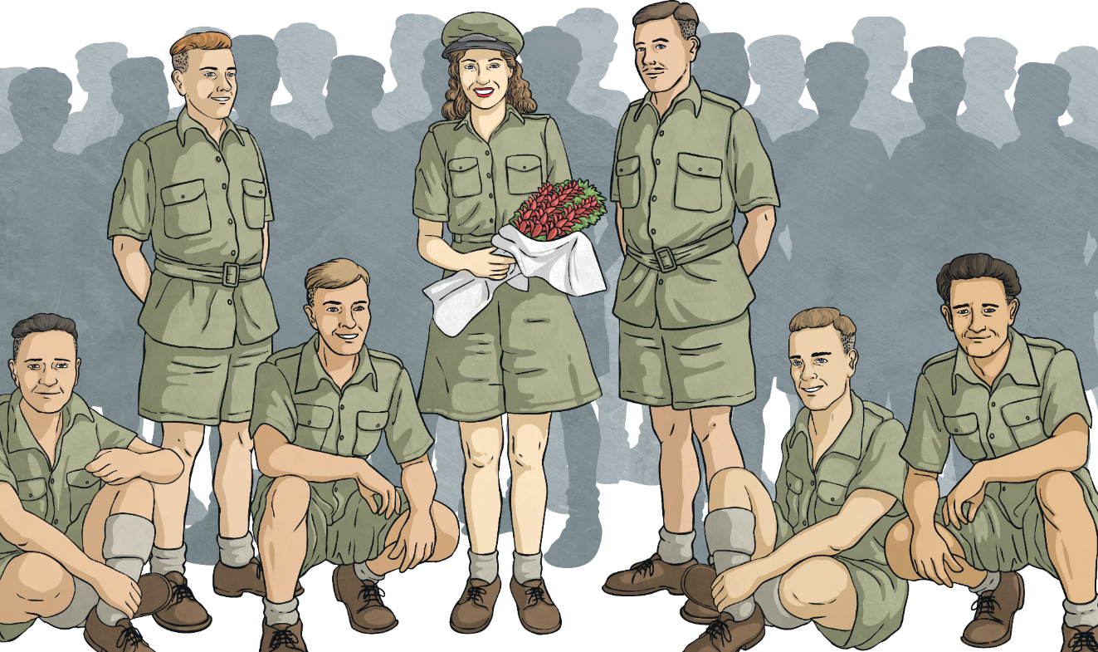
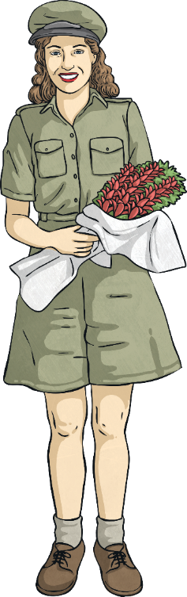
Dame Vera Lynn
Dame Vera Lynn was an English singer who was popular during the Second World War. This is because listeners could relate to her songs about love and missing their loved ones. She was given the nickname ‘The Forces’ Sweetheart’.
In late 1939, she premiered the famous song, ‘We’ll Meet Again’. The song is all about those people longing for their loved ones who have been separated because of the war.
Vera was given her own BBC radio show in 1941. The following year, she recorded ‘The White Cliffs of Dover’, another famous song which was about the end of the war.
Vera performed for troops in Egypt, India and Burma to raise morale.

Slide 11
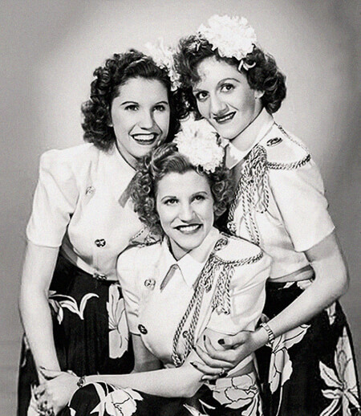
The Andrews Sisters
This trio from America became one of the most popular music acts in the 1940s. They sang swing songs in close harmony and sold millions of copies of their recordings.
Their fame peaked during the Second World War and they were nicknamed ‘America’s Wartime Sweethearts’.
Some of the Andrews Sisters’ best known hits included ‘Don’t Sit Under the Apple Tree’ and ‘Boogie Woogie Bugle Boy’.
harmony: Musical notes that are played or sung together for a pleasing effect.
trio: Three people.

Slide 12
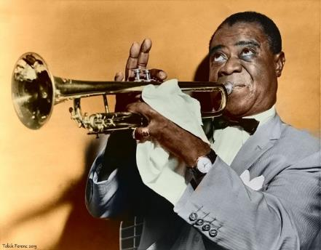
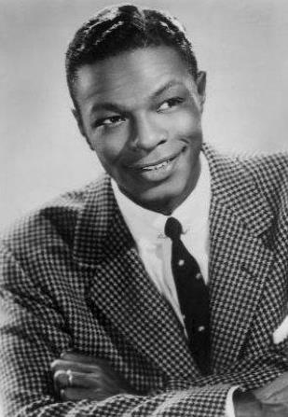
Jazz
A new type of jazz, called ‘bebop’, emerged during this era; it became known as modern jazz. Bebop was created by young jazz musicians. It was meant to be listened to, not danced to due to faster tempos. It focused more on musical improvisation. Traditional jazz musicians, such as Louis Armstrong, didn’t like the new style.
Jazz remained popular during the 1940s. Ella Fitzgerald, Nat King Cole and Louis Armstrong were some of most notable jazz artists of the time.
Louis Armstrong
improvisation: Make up the music as you play.
Nat King Cole
tempo: The speed of the music.

Slide 13
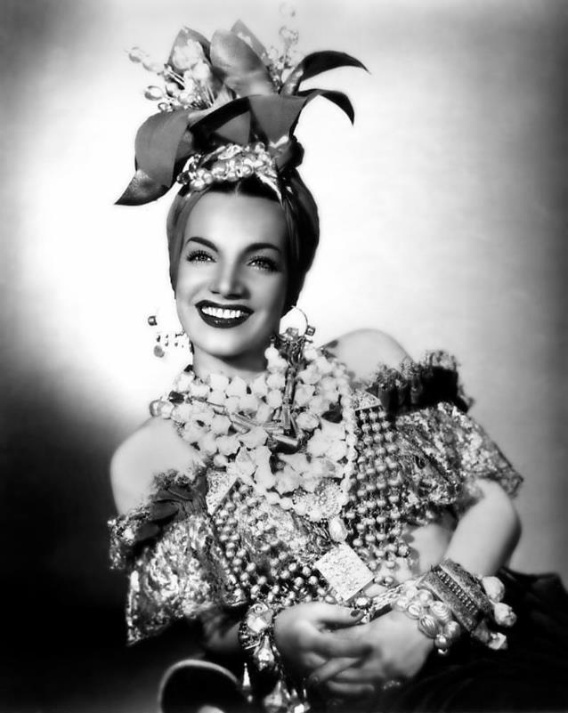
Latin Music
During the 1940s, Latin American music became popular. Some of the artists were solo singers, while others performed with the big bands of the day.
Carmen Miranda was very popular during the 1940s. She appeared in theatres, in films and was often heard on the radio. She was known for her iconic hats which featured fruit.
Latin American music: Latin American music is from the Spanish or Portuguese speaking countries of Mexico, most of Central and South America, and the Caribbean Islands.

Slide 14
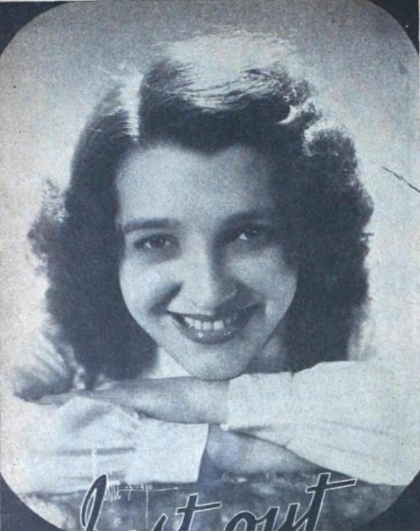
Country Music
Country music became popular during the 1940s. By the end of this decade, it became known as Country and Western music.
The popularity of this genre of music was helped by a genre of film called ‘westerns’.
Popular country stars of the time included the Carter Sisters and Jenny Lou Carson, who all topped the charts.
Bing Crosby and the Andrews Sisters released country songs
due to its popularity.
country music: Short for country and western. A style of American music which originated from the South and West in the early 20th century.
Jenny Lou Carson

Slide 15
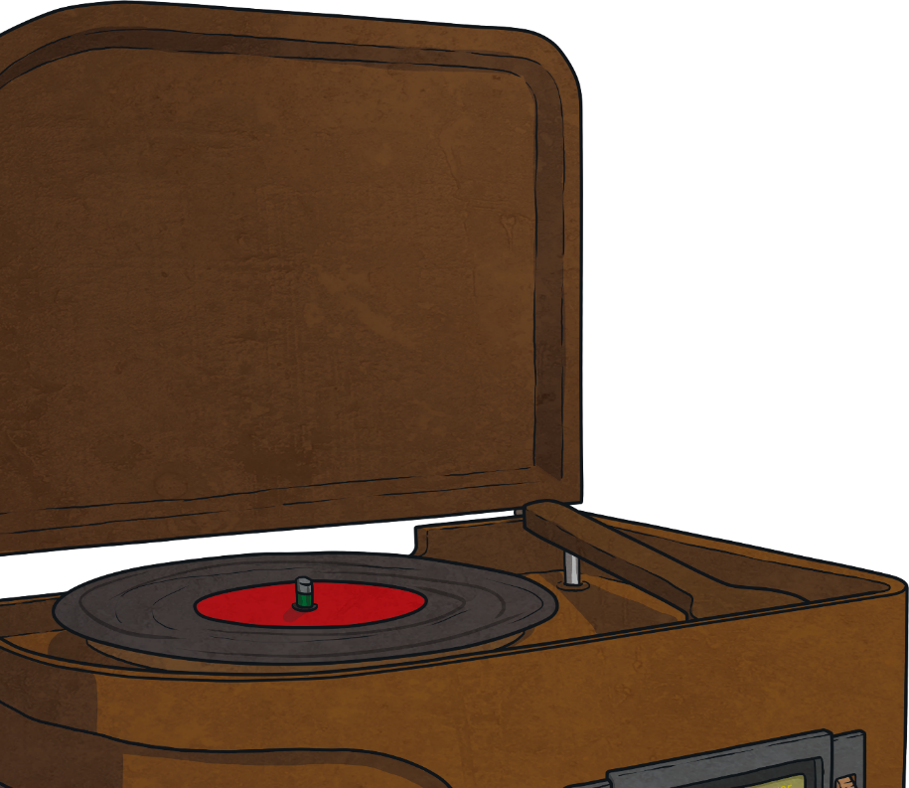

Phonographs
During the 1940s, phonographs became more affordable, giving listeners the power to choose what they listened to and when they listened to it.
They became known as record players.
Think About It!
How do you listen to music today?

Slide 16

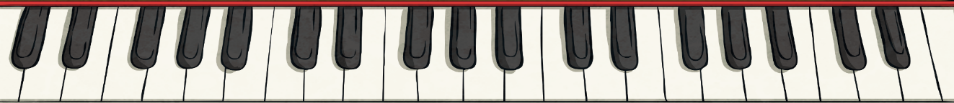
Songs of the 1940s
Some popular songs from the 1940s include:
‘Pennsylvania 6-5000’ by The Glenn Miller Orchestra
‘Moonlight Serenade’ by The Glenn Miller Orchestra
‘Harlem Air Shaft’ by Duke Ellington and his band
‘White Christmas’ by Bing Crosby
‘Boogie Woogie Bugle Boy’ by The Andrews Sisters
‘Do You Know What It Means To Miss New Orleans’ by Louis Armstrong
‘I, Yi, Yi, Yi, Yi
(I Like You Very Much)’
by Carmen Miranda
‘Jealous Heart’
by Jenny Lou Carson
‘Saturday Night (Is the Loneliest Night of the Week)’ by Frank Sinatra

Slide 17
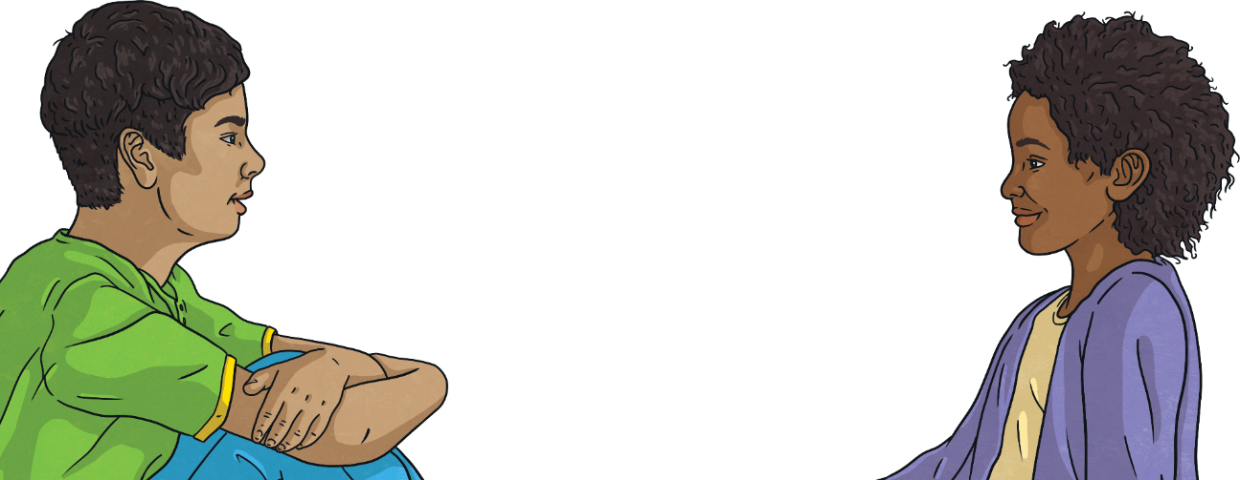
Listen
Which instruments can you hear?
Is it a solo singer or a group?
What would you say the
main theme of the song is?
How are the songs
different to modern music?
Do you like the music? Why? Why not?

